Slide 1

Data Structures And Algorithms Odd Semester 2022
Computer Science and Engineering
Jaypee Institute Of Information Technology (JIIT), Noida

Slide 2
Outline
Introduction to Branch and Bound
0/1 Knapsack problem using Branch and Bound

Slide 3
Branch and Bound Algorithm
The branch-and-bound problem solving method is very similar to backtracking in that a state space tree is used to solve a problem.
The differences are that B&B
does not limit us to any particular way of traversing the tree and
is used for optimization problems but only minimization problems.
There are three strategies of B&B algorithm and each of which is given below-
FIFO branch and bound
LIFO branch and bound
Least cost branch and bound

Slide 4
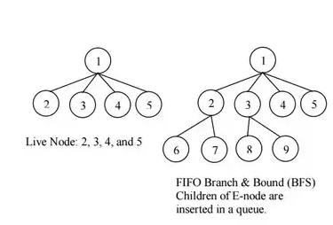
FIFO branch and bound
FIFO branch and bound is BFS.
In FIFO B&B children of active/expanded node(s) (live nodes) are inserted in queue.
1
2 | 3 | 4 | 5
3 | 4 | 5 | 6 | 7
4 | 5 | 6 | 7 | 8 | 9

Slide 5
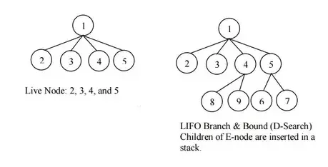
LIFO branch and bound
FLFO branch and bound is a D-search or DFS.
In LIFO, children of Expanded nodes are inserted in a stack using the Depth First Search Technique
1
5
4
3
2
7
6
4
3
2
9
8
3
2

Slide 6
Least count branch and bound
In this approach the node having minimum cost is explored first.
The same process is repeated to construct state- space tree.

Slide 7
0/1 Knapsack problem using Branch and Bound
Suppose weights and profits of n items are given and we have to put these items in a knapsack of capacity W to get the maximum total value in the knapsack. Assuming the constraint that You cannot break an item, either pick the complete item, or don’t pick it (0-1 property).
Example
Profit[] = {10, 10, 12,18};
weight[] = {2, 4, 6,9};
W = 15;
Since, 0/1 knapsack problem is maximization problem so first we convert this problem into minimization by making profit negative. Once we get the solution, it will be converted back to original. To solve this problem we use Least cost B&B.

Slide 8
0/1 Knapsack problem using Branch and Bound
Let us construct state space tree for the given data. For solving this problem using B&B we need upper bound and cost of each node.
Upper bound= sum of all the profit <= W
Cost= sum of all the profit (with fraction)[used for only solving the problems]
Solution can be either variable size i.e., (s1, s3) or fixed size (1,0,1,0). It means only first and third solution will be included.
First set upper bound= ∞ and update it if any smaller value appears
First compute cost and upper bound for profits. Since, W is 15 so, if we start with first node, then only 1st, 2nd, and 3rd node are included (2+4+6)and the cost and upper bound is computed as follows.
Cost= 10+10+12+(18*(15-12))/9 = 38 (fractional part is only used for computation)[we change it to -38]
Upper= 10+10+12=32 [we change it to -32]
Compare the new upper i.e., -32 with ∞ and update upper to -32
Create node 1 and put its cost and upper bound. Now check if we include first object (x1=1) and if we don’t include first object then what will be their cost and upper bound. From the state space tree given in next slide, it can be observed that cost of including fist object is less so the branch x1=1 will be included and x1=0 will be discarded. The same is repeated for all the possibility. Please refer next slide for explanation.

Slide 9
0/1 Knapsack problem using Branch and Bound
Here, the procedure to solve the problem is as follows are:
Calculate the cost function and the Upper bound for the two children of each node. Here, the (i + 1)^{th} level indicates whether the i^{th} object is to be included or not.
If the cost function for a given node is greater than the upper bound, then the node need not be explored further. Hence, we can kill this node. Otherwise, calculate the upper bound for this node. If this value is less than U, then replace the value of U with this value. Then, kill all unexplored nodes which have cost function greater than this value.
The next node to be checked after reaching all nodes in a particular level will be the one with the least cost function value among the unexplored nodes.
While including an object, one needs to check whether the adding the object crossed the threshold. If it does, one has reached the terminal point in that branch, and all the succeeding objects will not be included.
In this manner, we shall find a value of U at the end which eliminates all other possibilites. The path to this node will determine the solution to this problem.

Slide 10
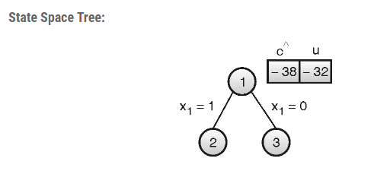
Example Profit[] = {10, 10, 12,18}; weight[] = {2, 4, 6,9}; W = 15; First compute cost and upper bound for profits. Since, W is 15 so, if we start with first node, then only 1st, 2nd, and 3rd node are included (2+4+6)and the cost and upper bound is computed as follows. Cost= 10+10+12+(18*(15-12))/9 = 38 (fractional part is only used for computation)[we change it to -38] Upper= 10+10+12=32 [we change it to -32]

Slide 11
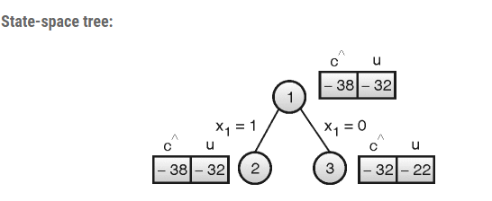
Here re-calculate cost and upper bound for both the possibilities for Item 1 (include/exclude) Here, cost of Node 2 is Smaller than Node 3, so explore node 2 .
Example
Profit[] = {10, 10, 12,18}; weight[] = {2, 4, 6,9}; W = 15;
(including item 1)
Cost = 10+10+12+(18*(15-12))/9 = 38
Upper= 10+10+12=32
(excluding item 1)
Cost = 10+12+(18*(15-10))/9 = 32
Upper= 10+12=22

Slide 12
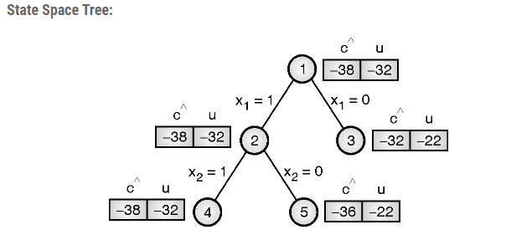
Here re-calculate cost and upper bound for both the possibilities for Item 2 (include/exclude) Here, cost of Node 4 is Smaller than Node 5, so explore node 4 .
Example
Profit[] = {10, 10, 12,18}; weight[] = {2, 4, 6,9}; W = 15;
(including item 2)
Cost = 10+10+12+(18*(15-12))/9 = 38
Upper= 10+10+12=32
(excluding item 2)
Cost = 10+12+(18*(15-8))/9 = 36
Upper= 10+12=22

Slide 13
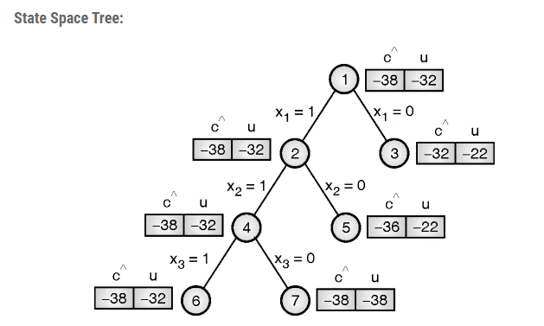
Here re-calculate cost and upper bound for both the possibilities for Item 3 (include/exclude) Here, there is a tie (cost) at Node 6 and Node 7, so explore any node. Lets say we explore node 7. Also, node 6 is not explored further, since adding any more weight exceeds the threshold
Example
Profit[] = {10, 10, 12,18}; weight[] = {2, 4, 6,9}; W = 15;
(including item 3)
Cost = 10+10+12+(18*(15-12))/9 = 38
Upper= 10+10+12=32
(excluding item 3)
Cost = 10+10+(18*(15-6))/9 = 38
Upper= 10+10+18= 38

Slide 14
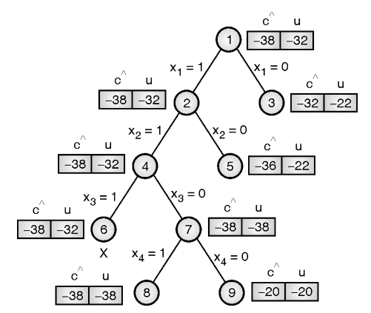
Here re-calculate cost and upper bound for both the possibilities for Item 4 (include/exclude) Here. At last level, node 8 has minimum cost, so node 8 would be the answer node.
Example
Profit[] = {10, 10, 12,18}; weight[] = {2, 4, 6,9}; W = 15;
(including item 4)
Cost = 10+10+12+(18*(15-12))/9 = 38
Upper= 10+10+18=38
(excluding item 4)
Cost = 10+10 = 20
Upper= 10+10= 20

Slide 15
Note: 1. Here that node 3 and node 5 have been killed after updating Upper bound (U) at node 7. 2. Also, node 6 is not explored further, since adding any more weight exceeds the threshold. 3. At the end, only nodes 6 and 8 remain. Since the value of U is less for node 8, we select this node. 4. Hence the solution is {1, 1, 0, 1}, and we can see here that the total weight is exactly equal to the threshold value in this case.

Slide 16
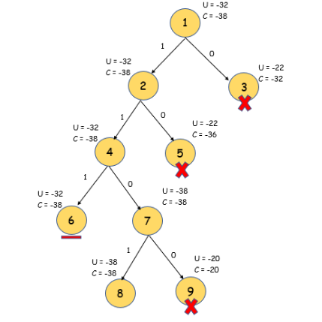
Here re-calculate cost and upper bound for both the possibilities for Item 4 (include/exclude) Here. At last level, node 8 has minimum cost, so node 8 would be the answer node. By tracing from node 8 to root, we get item 4, 2 and 1 in the knapsack. Solution vector X = {x1, x2, x4} and profit = p1 + p2 + p4 = 38
Example
Profit[] = {10, 10, 12,18}; weight[] = {2, 4, 6,9}; W = 15;

Slide 17
0/1 Knapsack problem using Branch and Bound
Time and Space Complexity
Even though this method is more efficient than the other solutions to this problem, its worst case time complexity is still given by O(2^{n}), in cases where the entire tree has to be explored. However, in its best case, only one path through the tree will have to explored, and hence its best case time complexity is given by O(n). Since this method requires the creation of the state space tree, its space complexity will also be exponential.

Slide 18
References
https://iq.opengenus.org/0-1-knapsack-using-branch-and-bound/
https://codecrucks.com/knapsack-problem-using-branch-and-bound/

